Slide 1

Astrosage Operational Analysis
by Arnav Bangaria
Astrosage

Slide 2

Trusted Astrological Resource: AstroSage is recognized as one of the most authentic platforms for both general astrological assistance and advanced astrological research, catering to a wide range of user needs—from everyday concerns to specialized queries.
Founded by a Renowned Astrologer: Established in 2000 by Pt. Punit Pandey, a respected and experienced astrologer, AstroSage is built on a foundation of deep astrological knowledge and a mission to use astrology for the betterment of humanity.
Expert-Led Multidisciplinary Team: Guided by Pt. Punit Pandey, the AstroSage team includes expert astrologers from diverse schools such as KP, Lal Kitab, and Nadi, ensuring a practical and multi-dimensional approach to astrological solutions.
Astrosage is the first astrology app to cross 10 Million app downloads

Slide 3
PROBLEM STATEMENT
Astrosage has received an investment of 1 Crore. The goal is to determine how to allocate this investment to maximize operational efficiency, customer satisfaction, and profitability.

Slide 4
DATA OVERVIEW
Total No. of Sessions (records): 27882
Count of Unique Users: 10344
Count of Unique Gurus: 131
Offered Products (Consultation Types):
Call
Chat
Complementary
Public Live Call
Total No. of Attributes in Data: 36 attributes
Single Table having key highlights is time-series data, categorical data, and ratings

Slide 5
METHODOLOGY
Data Cleaning
Reduced attributes that have very low significance in our analysis these include columns that all values as FALSE i.e., isWhiteListUser, queue, and columns that have a single value i.e., callChannel, callvrType
Removing data points in CallSid where no significant data is captured and formatting guruName column
Data Manipulation
Manipulated columns to bring them in the right date-time format using DATE and TEXT functions in createdAT and updatedAt columns
Manipulated column chatStartTime and chatEndTime by first using Text to Column feature to remove extra character after “.”, then replaced character “T” with white space at the end using TIME and MID formula to extract only time values.
Removing Duplicates or Inconsistent guruName and making it in proper format
Descriptive Analysis:
Utilized pivot tables to find informative details from the dataset
Trend Analysis and Visualization:
Used charts and formulas to visualise and extract insightful data and patterns that will help us in better decision making

Slide 6
PLATFORM TYPE ANALYSIS
There are 3 platforms: App, Dashboard, and Gurucool
Gurucool is the most interacted platform, followed by the app; together, they hold 99.99% of sessions

Slide 7
PLATFORM TYPE ANALYSIS
App is a better platform in terms of revenue, astrologers’ earnings, and gross profit than Gurucool
The app has the highest Gross Profit per Session, standing at 8.92
The app generates approx. 4 times more profit as compared to Gurucool

Slide 8
PRODUCT TYPE ANALYSIS
There are 4 products: Calls, Chats, Complementary, and Public Live Call
Chats are the most interacted product type, followed by Calls; together, they hold 99.98% of sessions

Slide 9
PRODUCT TYPE ANALYSIS
Calls are a better product in terms of revenue, astrologers’ earnings, and gross profit than Chats
Calls generate approx. 9 times more profit as compared to Chats

Slide 10
CUSTOMER SATISFACTION ANALYSIS
Chats have a high number of failed and incomplete calls, which results in this product having lower customer retention, less revenue generation, and lower customer satisfaction

Slide 11
CUSTOMER SATISFACTION ANALYSIS
Calls have a high number of completed status, which helps in customer retention, revenue generation, and customer satisfaction.

Slide 12
TIME SERIES ANALYSIS
December 2023 saw the highest active users in a single day, and January 2024 saw the lowest active users in a single day
Active users declined constantly from 15th December 2023
Call volumes decrease when there is an increase in active users, but Chat volume increases, matching active users
Call volumes came in a decreasing trend after their peak on 9th December 2023, and Chat volumes decreased after the day that saw maximum active users

Slide 13
TIME SERIES ANALYSIS
The number of active users directly impacts revenue in a day; higher revenue was observed when there were more active users
There is a declining trend in active users and revenue after their peak on 15th December 2023

Slide 14
TIME SERIES ANALYSIS
Gross profit is directly related to average call duration in a day; a higher average call duration leads to a higher gross profit
Gross profit has declined as average call duration has slowed down from past few weeks

Slide 15
MAJOR PROBLEMS
1
Declining Active Users because of a higher failure rate in Chats and Calls
2
Lower customer satisfaction on Chats and Calls, causing low customer retention
3
Higher drop-off rate in peak times because of limited agents

Slide 16
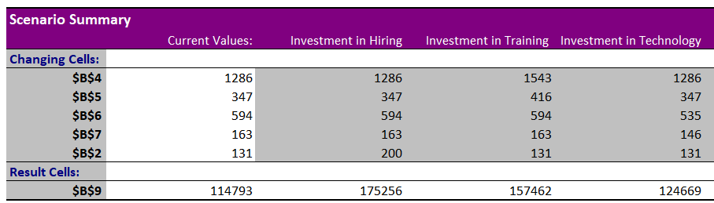
SUGGESTIONS
Investment Domains | % to Invest | Improvements | Risks
Hiring New Agents | 40% | Reduce the workload on the existing agents Increase user’s on-call duration when there is high call volumes Improve customer satisfaction level during peak times | Creates competition amongst existing agents Additional investment in training sessions for new agents
Improving Training Programs | 40% | Increase customer satisfaction, resulting in better ratings Higher ratings will allow for an increase session amount of agents, resulting in a revenue boost | Agents can charge more per session, which may impact customer behaviour
Upgrading Call Centre Technology | 20% | Integrating AI chat in consultation type that have higher volumes than calls but still generate low revenue | Upfront investment cost can be high

Slide 17
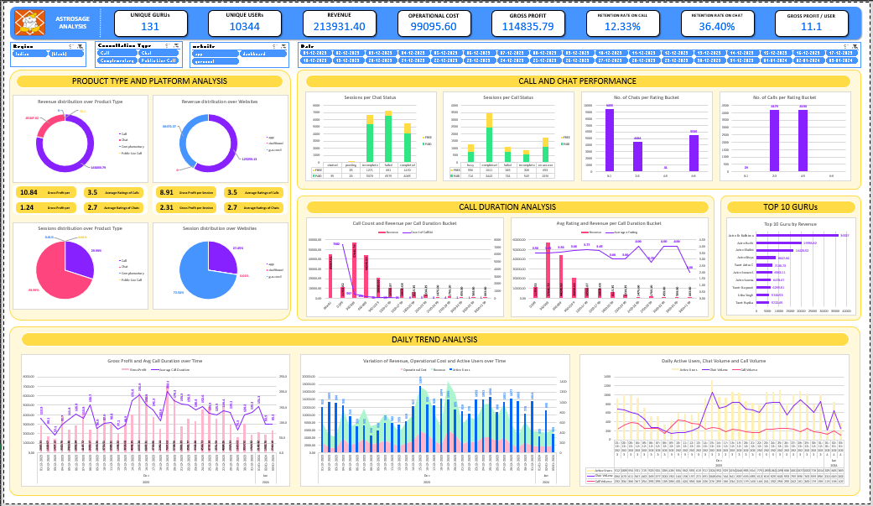
DASHBOARD

Slide 18
CONCLUSION
1
Hire more agents to reduce workload, reduce failure rate and improve customer handling
2
Invest in agent training to improve customer engagement, satisfaction and average on-call duration of users
3
Invest in call scheduling and chat automation system implementing AI to handle large volume and reduce drop-off rate

Slide 19
THANK YOU

